Slide 1
AstroEngr 331X
Getting to Orbit:
Launch Velocities
Rockets
Launch Environment
May 2024

Slide 2
Agenda
Launch Vehicle Ascent Phases
Launch Environment
Calculating ΔV_{design}
Converting mass (rocket fuel) to ΔV

Slide 3
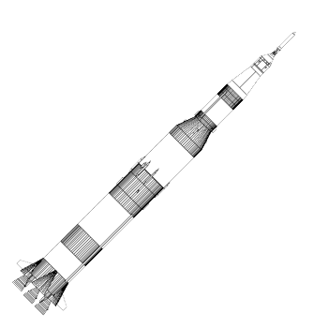
Launch Vehicle Ascent Phases
3. vacuum
2. pitch over
1. vertical ascent

Slide 4
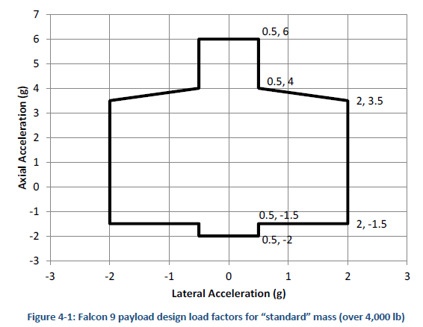
Launch Vehicle G-load Profile

Slide 5
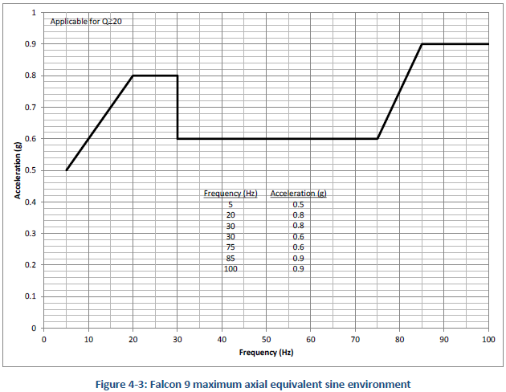
Launch Vehicle Vibration Profile

Slide 6
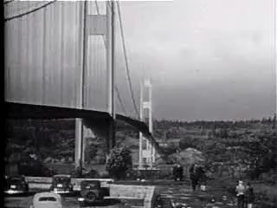
Launch Environment Impact on Satellite Design
Launch is by far the most challenging environment for a satellite’s structure
Static loads of multiple g’s in multiple directions
Vibrations across a range of frequencies
Structure must be strong, yet low mass
Total satellite mass is still one of the largest drivers of launch cost
Structure must be built to avoid resonance

Slide 7

$$\left|ΔV_{Needed}\right|= ???$$
Launch Velocities
$$ΔV_{Design}=\left|ΔV_{Needed}\right|+V_{Losses(OtherThanGravity)}$$
$$\left|ΔV_{Needed}\right|={\overset{⃑}{V}}_{Burnout}−{\overset{⃑}{V}}_{Launch Site}+{\overset{⃑}{V}}_{Losses Gravity}$$

Slide 8
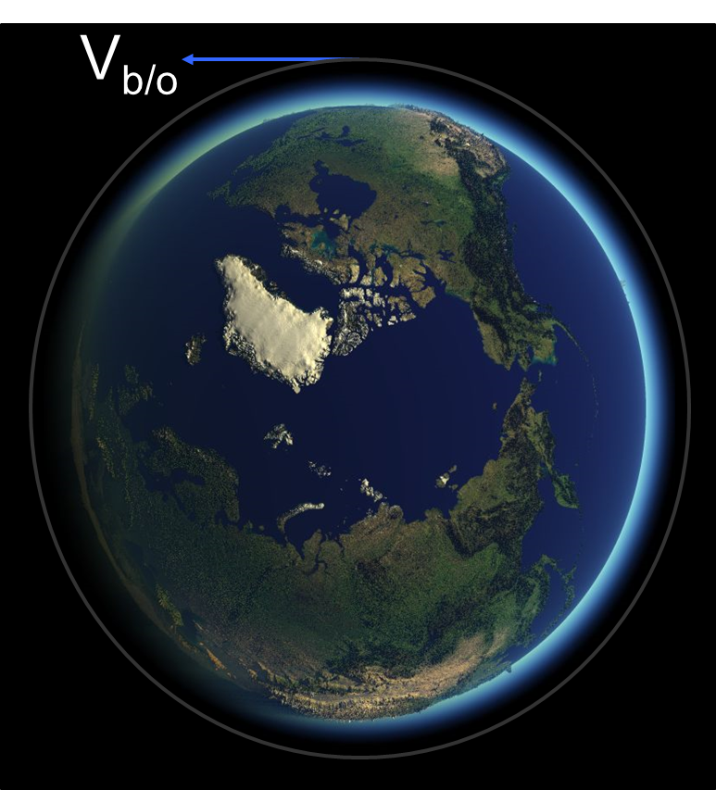
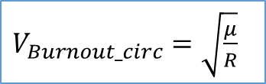
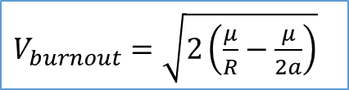
Velocity at Burnout
$V_{burnout}=\sqrt{2\left(\frac{μ}{R}−\frac{μ}{2a}\right)}$
-OR-
$V_{Burnout_circ}=\sqrt{\frac{μ}{R}}$

Slide 9
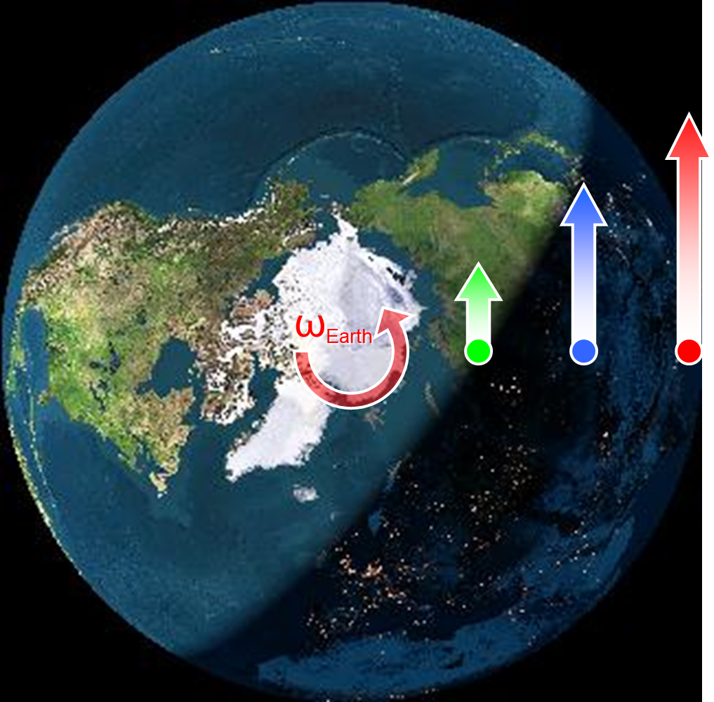
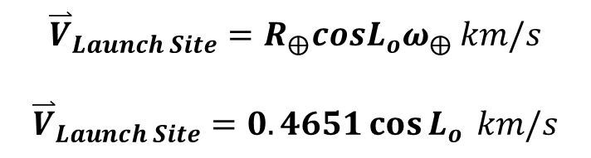
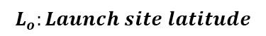
Launch Site Velocity
Velocity = distance from Earth’s axis of rotation multiplied by Earth’s rotation rate of 15 deg / hr
$${\overset{⃑}{V}}_{Launch Site}=R_{⨁}cosL_{o}ω_{⨁} km/s$$
$${\overset{⃑}{V}}_{Launch Site}=0.4651\cos{L_{o}} km/s$$
$$L_{o}:Launch site latitude$$
Notes:
Velocity = distance from Earth’s axis of rotation multiplied by Earth’s rotation rate of 15.04 deg/hr (solar time)
Further distance from the NP = greater velocity

Slide 10
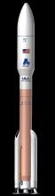
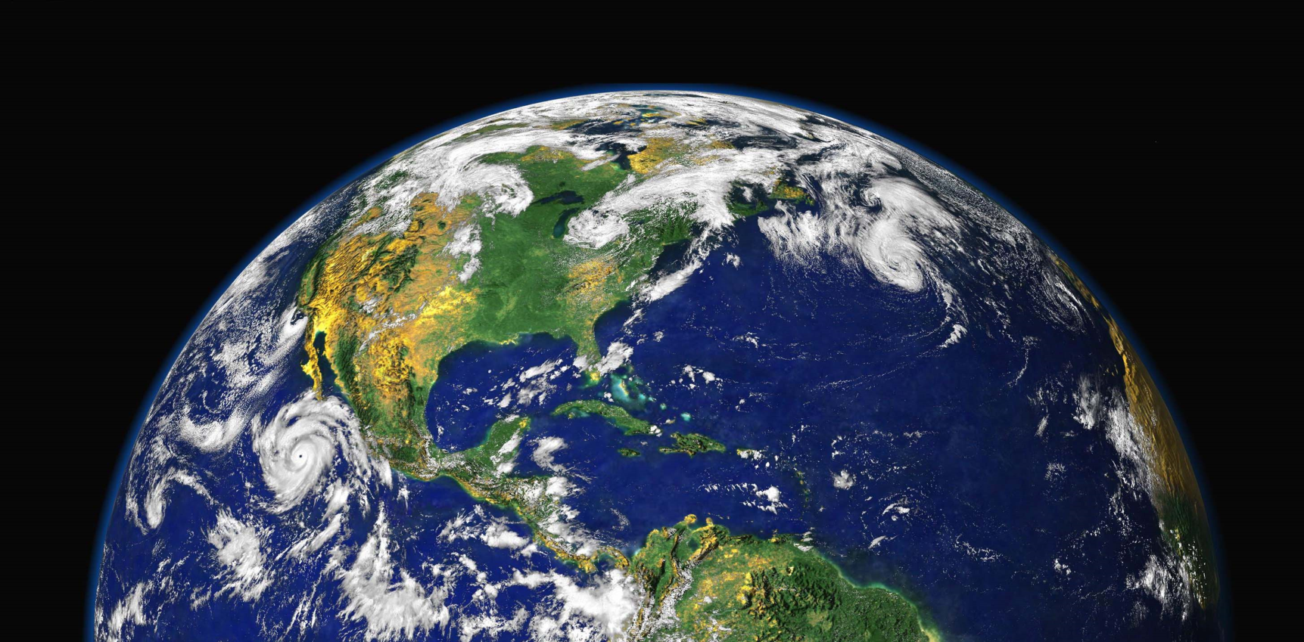


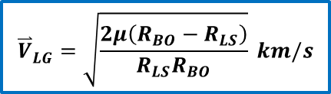
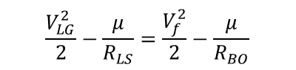

Losses due to Gravity
$$ε_{i}=ε_{f}$$
0
$$\frac{V_{LG}^{2}}{2}−\frac{μ}{R_{LS}}=\frac{V_{f}^{2}}{2}−\frac{μ}{R_{BO}}$$
$${\overset{⃑}{V}}_{LG}^{}=\sqrt{\frac{2μ\left(R_{BO}−R_{LS}\right)}{R_{LS}R_{BO}}} km/s$$
$$R_{BO}$$
$$R_{LS}=R_{earth}$$

Slide 11
Launch Velocity Equation
$$ΔV_{Design}=\left|ΔV_{Needed}\right|+V_{Losses(OtherThanGravity)}$$
$$\left|ΔV_{Needed}\right|={|\overset{⃑}{V}}_{Burnout}−{\overset{⃑}{V}}_{Launch Site}+{\overset{⃑}{V}}_{Losses Gravity}|$$
Achieving orbital velocity
Velocity from Earth’s rotation
Achieving orbital altitude
Achieving orbital velocity
Velocity from Earth’s rotation
Achieving orbital altitude

Slide 12

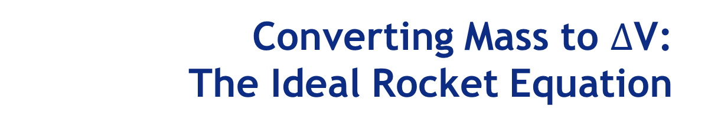
Converting Mass to $∆$V: The Ideal Rocket Equation
$∆$V = I_{sp}${ g}_{0}$ ln$\left(\frac{m_{i}}{m_{f}}\right)$
where
I_{sp} = specific impulse (seconds)
g_{o} = Earth’s gravity (0.00981 km/s²)
m_{i} = initial mass before motor is fired (kg)
m_{f} = final mass after propellant burned (kg)
ΔV = change in velocity produced by rocket (km/s)

Slide 13
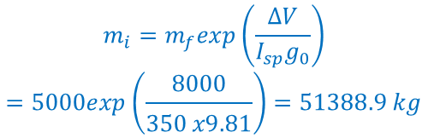
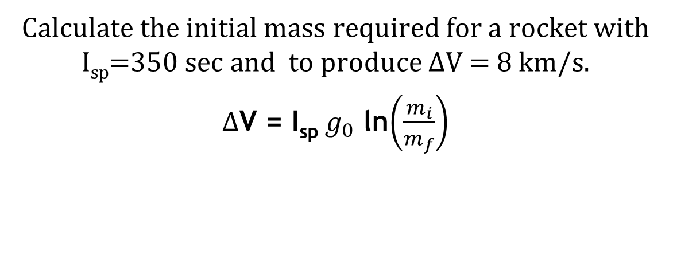
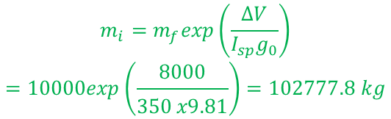
The Ideal Rocket Equation Example
Calculate the initial mass required for a rocket with I_{sp}=350 sec and to produce $∆$V = 8 km/s.
$∆$V = I_{sp}${ g}_{0}$ ln$\left(\frac{m_{i}}{m_{f}}\right)$
Group 1
Given m_{f} = 5,000 kg
Group A
Given m_{f} = 10,000 kg
$$m_{i}=m_{f}exp\left(\frac{ΔV}{I_{sp}g_{0}}\right)$$
$$=5000exp\left(\frac{8000}{350 x9.81}\right)=51388.9 kg$$
$$m_{i}=m_{f}exp\left(\frac{ΔV}{I_{sp}g_{0}}\right)$$
$$=10000exp\left(\frac{8000}{350 x9.81}\right)=102777.8 kg$$

